Slide 1
Protean Manifestations of CHF and the lungs
Diurese, then diagnose

Slide 2
DIURESE THEN DIAGNOSE

Slide 3
Classic teachings: APE. Not Chronic HF
https://emcrit.org/ibcc/scape/

Slide 4
Physical exam findings
https://www.jacc.org/doi/10.1016/j.jchf.2018.04.005
https://www.cardionerds.com/142-the-role-of-the-clinical-examination-in-patients-with-heart-failure-with-dr-mark-drazner/

Slide 5
Imaging Findings
https://twitter.com/doc_BLocke/status/1433090969830756358?s=20

Slide 6
CHF
Stage 1: interstitial fluid (can be up to 500mL with minimal extra pressure)
Stage 2 Crescentic filling of the alveoli
Stage 3 Alveolar Flooding
Stage 4 Froth in air passages
Historically taught that hypoxemia and stimulation to vagal nociceptors results in hyperventilation – which may be true, until load is too great
Notes:
Patients with chronic congestive heart failure only get alveolar edema in severe states of fluid overload. More than 500mL of fluid is absorbed in the interstitial space (=lack of usefulness of crackles), and clearance w chronicity. https://ejropen.com/article/S2352-0477(20)30063-0/fulltext…

Slide 7
VO2 Stress test findings

Slide 8
Capillary Injury
https://journals.physiology.org/doi/pdf/10.1152/jappl.2000.89.6.2483

Slide 9
Hyperventilation?

Slide 10
Colloid Oncotic Pressure – revised starling
https://pubmed.ncbi.nlm.nih.gov/6845168/
Colloids do not help with noncardiogenic pulmonary edema.
Cardiogenic pulmonary edema?
Starling equation
Bronch study?

Slide 11
Pulm Edema DAD
https://www.atsjournals.org/doi/full/10.1164/rccm.202008-3149IM

Slide 12
Woodcock / Glycocalyx?

Slide 13
Minerva Anestesiologica 2022 April;88(4):308-13
DOI: 10.23736/S0375-9393.22.16195-X
Notes:
Patients with established chronic heart failure
(CHF) often display increased pulmonary venous
pressure,18 but the correlation with lung congestion
is surprisingly weak and some patients can
tolerate even marked elevations of left atrial
pressure without developing signs of lung con
gestion. This could be explained by chronic
19, 20
adaptation to increased pulmonary venous pressure
with basal membrane thickening, reduced capillary filtration,
and increased lymphatic 21, 22 drainage
.23
18. Staub NC. Pulmonary edema. Physiol Rev 1974;54:678– 811.
19. Mahdyoon H, Klein R, Eyler W, Lakier JB, Chakko SC, Gheorghiade M. Radiographic pulmonary congestion in end-stage congestive heart failure. Am J Cardiol 1989;63:625–7.
20. Chakko S, Woska D, Martinez H, de Marchena E, Futterman L, Kessler KM, et al. Clinical, radiographic, and hemodynamic correlations in chronic congestive heart failure: conflicting results may lead to inappropriate care. Am J Med 1991;90:353–9.
21. Dixon DL, Mayne GC, Griggs KM, De Pasquale CG, Bersten AD. Chronic elevation of pulmonary microvascular pressure in chronic heart failure reduces bi-directional pulmonary fluid flux. Eur J Heart Fail 2013;15:368–75.
22. Townsley MI, Fu Z, Mathieu-Costello O, West JB. Pulmonary microvascular permeability. Responses to high vas
cular pressure after induction of pacing-induced heart failure in dogs. Circ Res 1995;77:317–25.
23. Gheorghiade M, Follath F, Ponikowski P, Barsuk JH, Blair JE, Cleland JG, et al.; European Society of Cardiology; European Society of Intensive Care Medicine. Assessing and grading congestion in acute heart failure: a scientific statement from the acute heart failure committee of the heart failure association of the European Society of Cardiology and endorsed by the European Society of Intensive Care Medicine. Eur J Heart Fail 2010;12:423–33

Slide 14
10 questions for acute pulmonary edema
https://link.springer.com/article/10.1007/s00134-022-06639-8
Up to 20 fold increase in work of breathing.
Loop diuretics = venodilator; NIV -> Loop diuretic -> vasodil if BP above target
Strategies for readmission risk reduction:
Achieve decongestion, treat comorbidities, and initate and restart oral medications
Mir. ., Peacock FW, McMurray JJ, Bueno H, Christ M, Maisel AS, Cullen L, Cowie MR, Di Somma S, Mart.n S.nchez FJ, Platz E, Masip J, Zeymer U, Vrints C, Price S, Mebazaa A, Mueller C, Acute Heart Failure Study Group of the ESC Acute Cardiovascular Care Association (2017) European Society of Cardiology-Acute Cardiovascular Care Association position paper on safe discharge of acute heart failure patients from the emergency department. Eur Heart J Acute Cardiovasc Care 6:311–320. https://doi.org/10.1177/ 20488 72616 633853

Slide 15
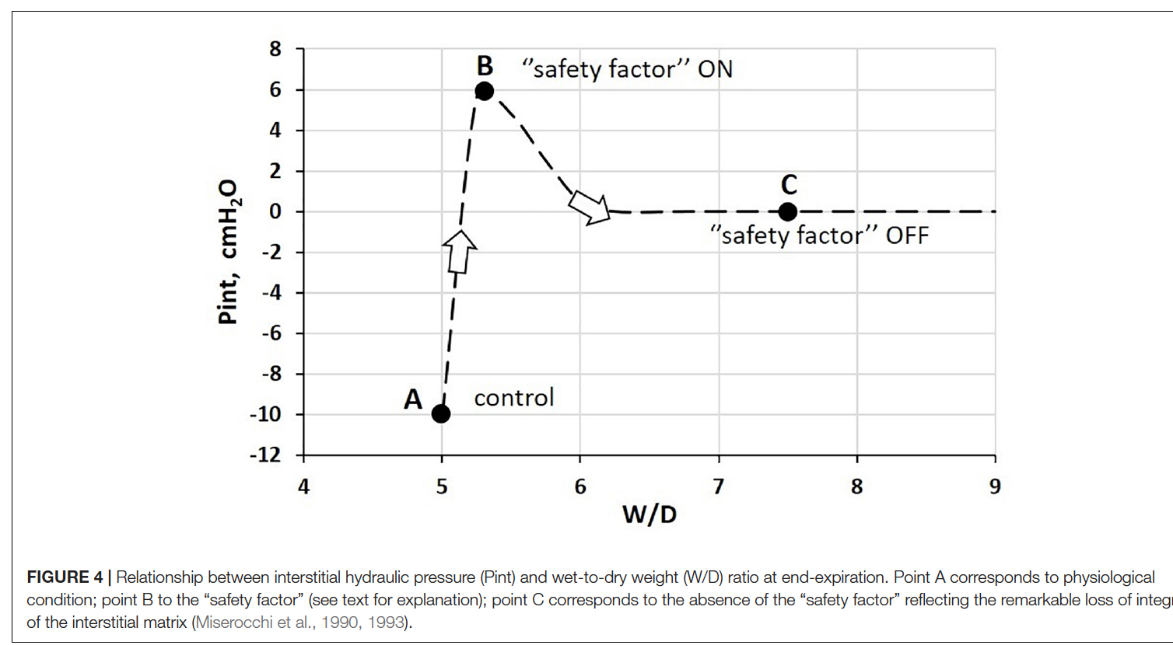
doi: 10.3389/fphys.2021.781874
Interstitial fluid flux: subject to starling forces, Wet-to-Dry index summarizes flux. “Safety factor” = formation of interstitial gel.
Usual ’flux’ = Na+ dependent reabsorption
Note: point B can occur due to increased CO (e.g. marathon running) and is well compensated unless the “safety factor” mechanism is lost
Inflammation (whether sterile or non-sterile) leads to loss of this mechanism
Specifically, overdistention, ROS implicated
Notes:
Citation:
Beretta E, Romanò F, Sancini G,
Grotberg JB, Nieman GF and
Miserocchi G (2021) Pulmonary
Interstitial Matrix and Lung Fluid
Balance From Normal to the Acutely
Injured Lung.
Front. Physiol. 12:781874.

Slide 16
doi: 10.3389/fphys.2021.781874
Factors protective against edema:
Initially, fluid accumulates in the thick portion of the interstitium
In normal conditions, most fluid returns to the capillaries by starling forces, 18% by lymphatics
In edematous states, lymphatics increase 8-10 fold
Notably, PEEP will interfere with this process (pushing back toward starting forces)
Precapillary vasoconstriction -> divert blood flow away from portion of lung with high W/D ratio. This has significant inter-individual variation that may contribute to individuals “prone-ness” to edema formation.
Importantly – derangements/loss of protective factors can be regional /distention related, and thus “geographic” even when “cardiogenic”
Notes:
Implication: is the wedge really telling us that much about edema? No – but may be a stratificatiotn of “cardiogenic” vs “non-cardiogenic” aka permability mediated. )
Changes in Starling gradients and permeability parameters
may be combined differently within the whole lung. In fact,
the available experimental evidence confirms the heterogeneity
in both regional lung fluid accumulation and perfusion under
edemagenic conditions (Bachofen et al., 1993). Basal lung regions
are, in general, more exposed to edema because of greater
blood perfusion, implying higher capillary Kf (Rivolta et al.,
2011). Alveolar flooding was found to occur in a quite nonhomogeneous
fashion revealing considerable regional differences
Since the distribution of edema is heterogeneous by nature,
in the lung portions where W/D < 6.5, the control of lung
fluid balance is only possible when the built-in safety factors,
intact matrix, interstitial capacity, and lymphatics not yet
saturated, are still functional.
(Wu et al., 1995).

Slide 17
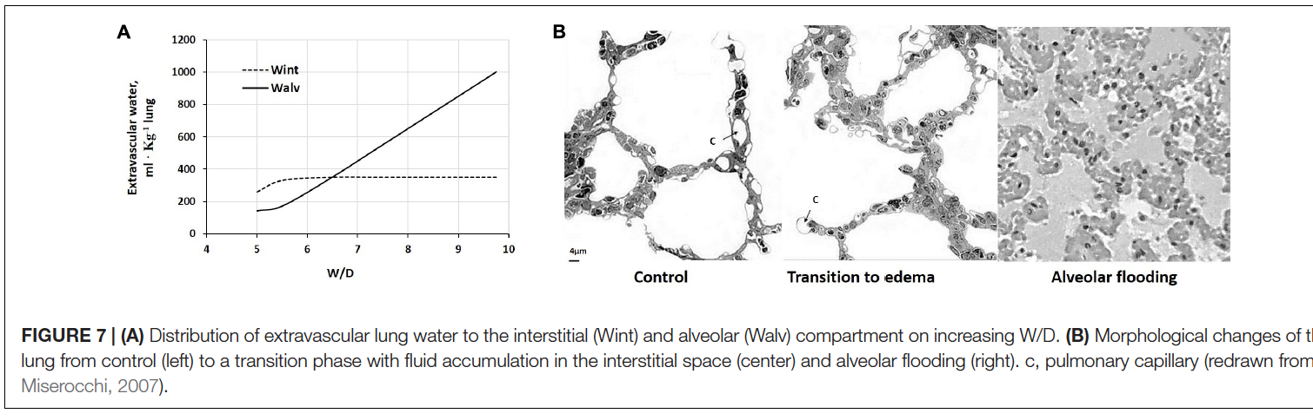
doi: 10.3389/fphys.2021.781874
When does interstitial edema become alveolar edema?
Vessel -> intstitium = transendothelial (PEEP doesn’t help); interstitium -> alveolar = transepithelial (PEEP helps, worsened by lung injury)
Interstitial edema = ~5.5 W/D ratio, Alveolar begins to occur ~6 -6.25.
Alveolar flooding happens fast ~3 minute time constant.

Slide 18
CHF and lymphatics
https://www.ahajournals.org/doi/10.1161/JAHA.122.026668

